Slide 1
Conditional Random Field [1]
Joohyung Lee

Slide 2
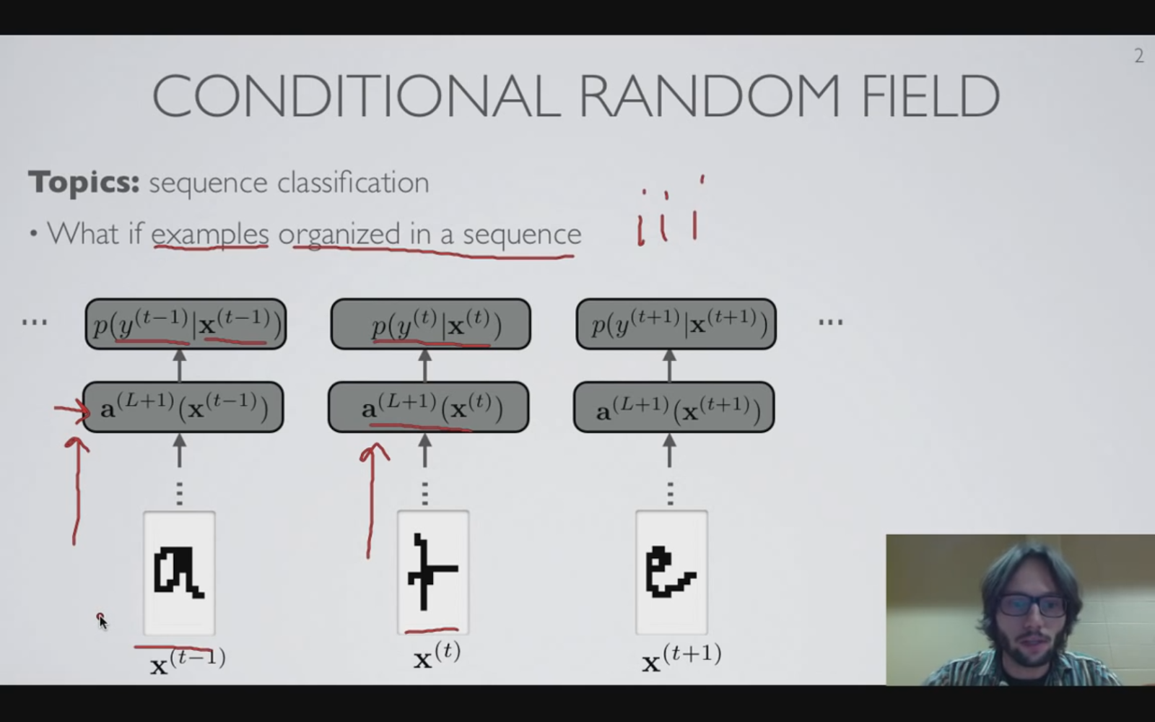
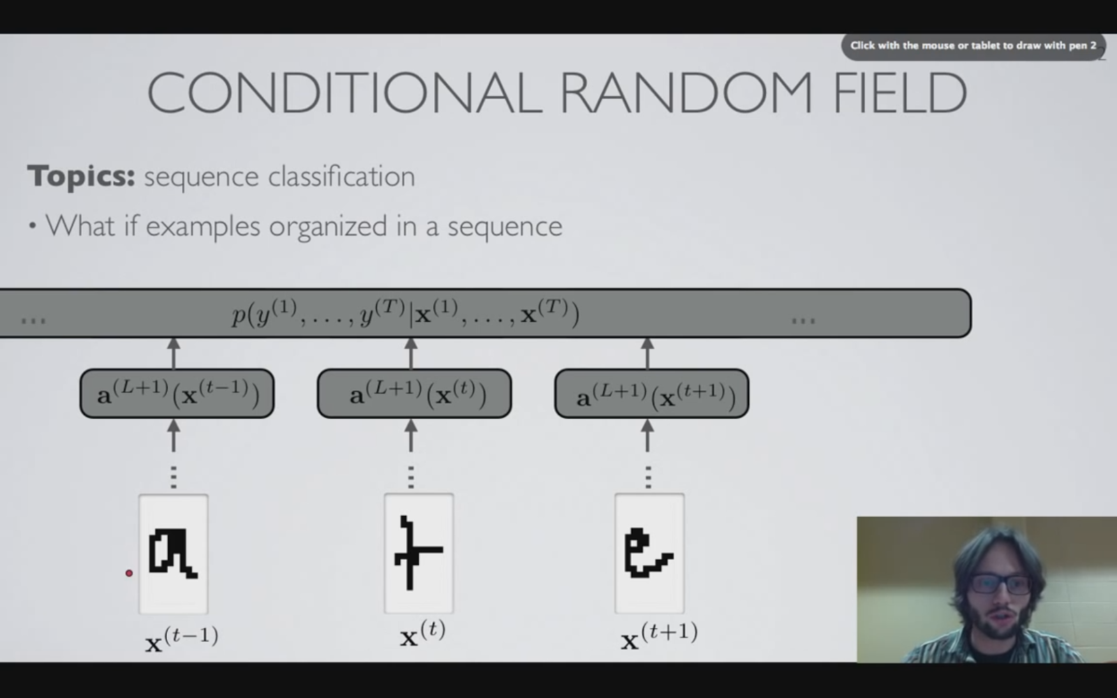
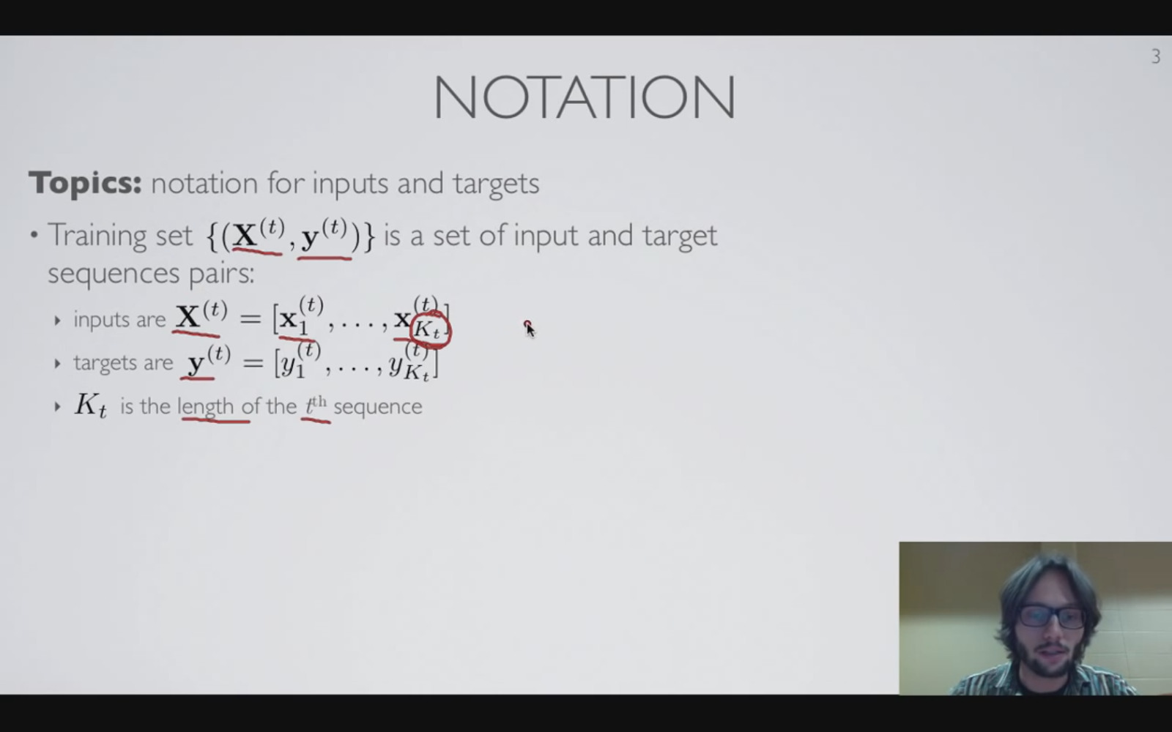
Motivation
Memoryless
Bernoulli process, Poisson process vs. Markov chains
동전 던지기
Difference
In a case of sequential examples, knowing the label of the previous data can help predicting the current datum (not independent)
Joint distribution (not mere multiplication)
NEW GOAL
Compute the joint probability distribution (considering dependency) of the whole set of possible sequences of outcomes

Slide 3
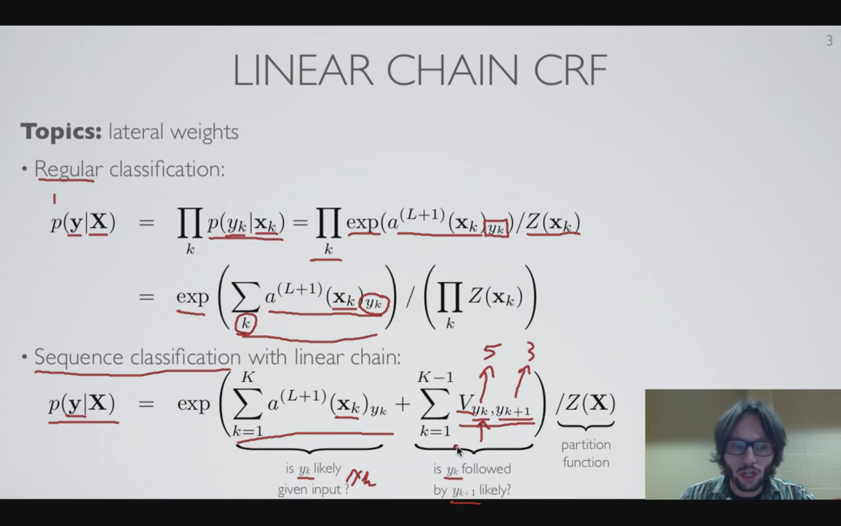
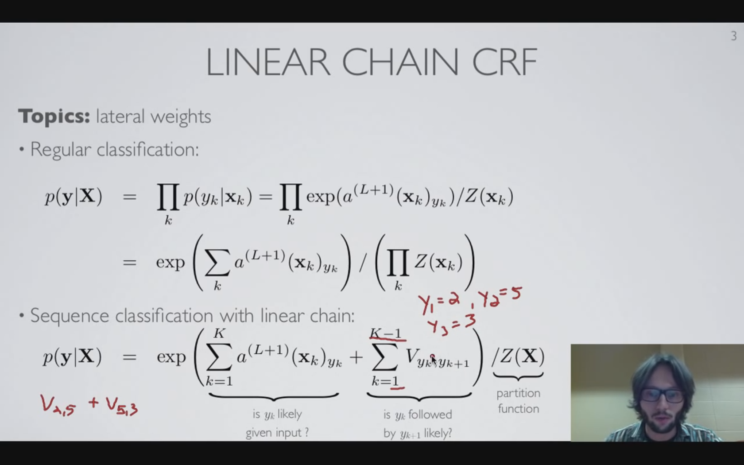
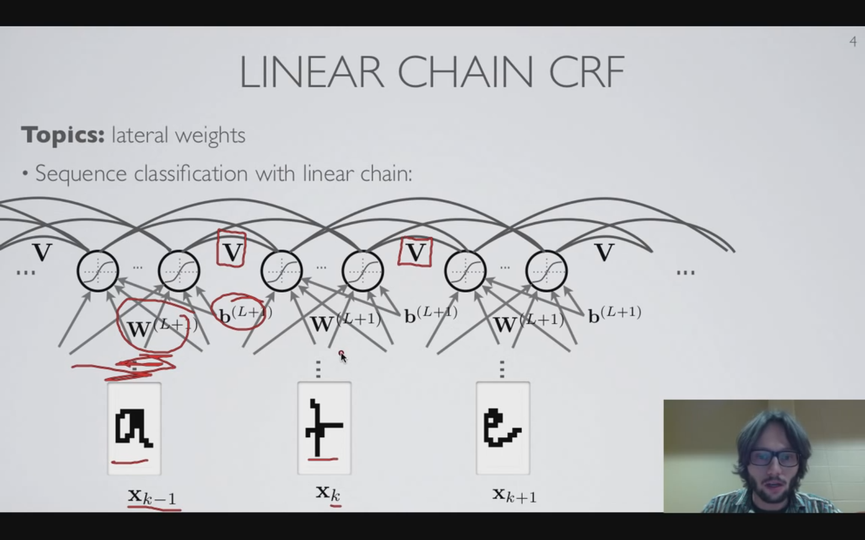
Linear chain CRF
Most simple CRF: Linear Chain CRF
No dependency between adjacent node of a sequence
Mere multiplication
Multiplication = sum in power
Dependency considered (CRF)
Unary log-factor
Pairwise log factor
Exactly same (shared) network of both log factor for every position K within a sequence: same gradient vector and thus same parameter update
Consistent lateral connection
Supplementary
Y having possible number of its state (# of classes)

Slide 4
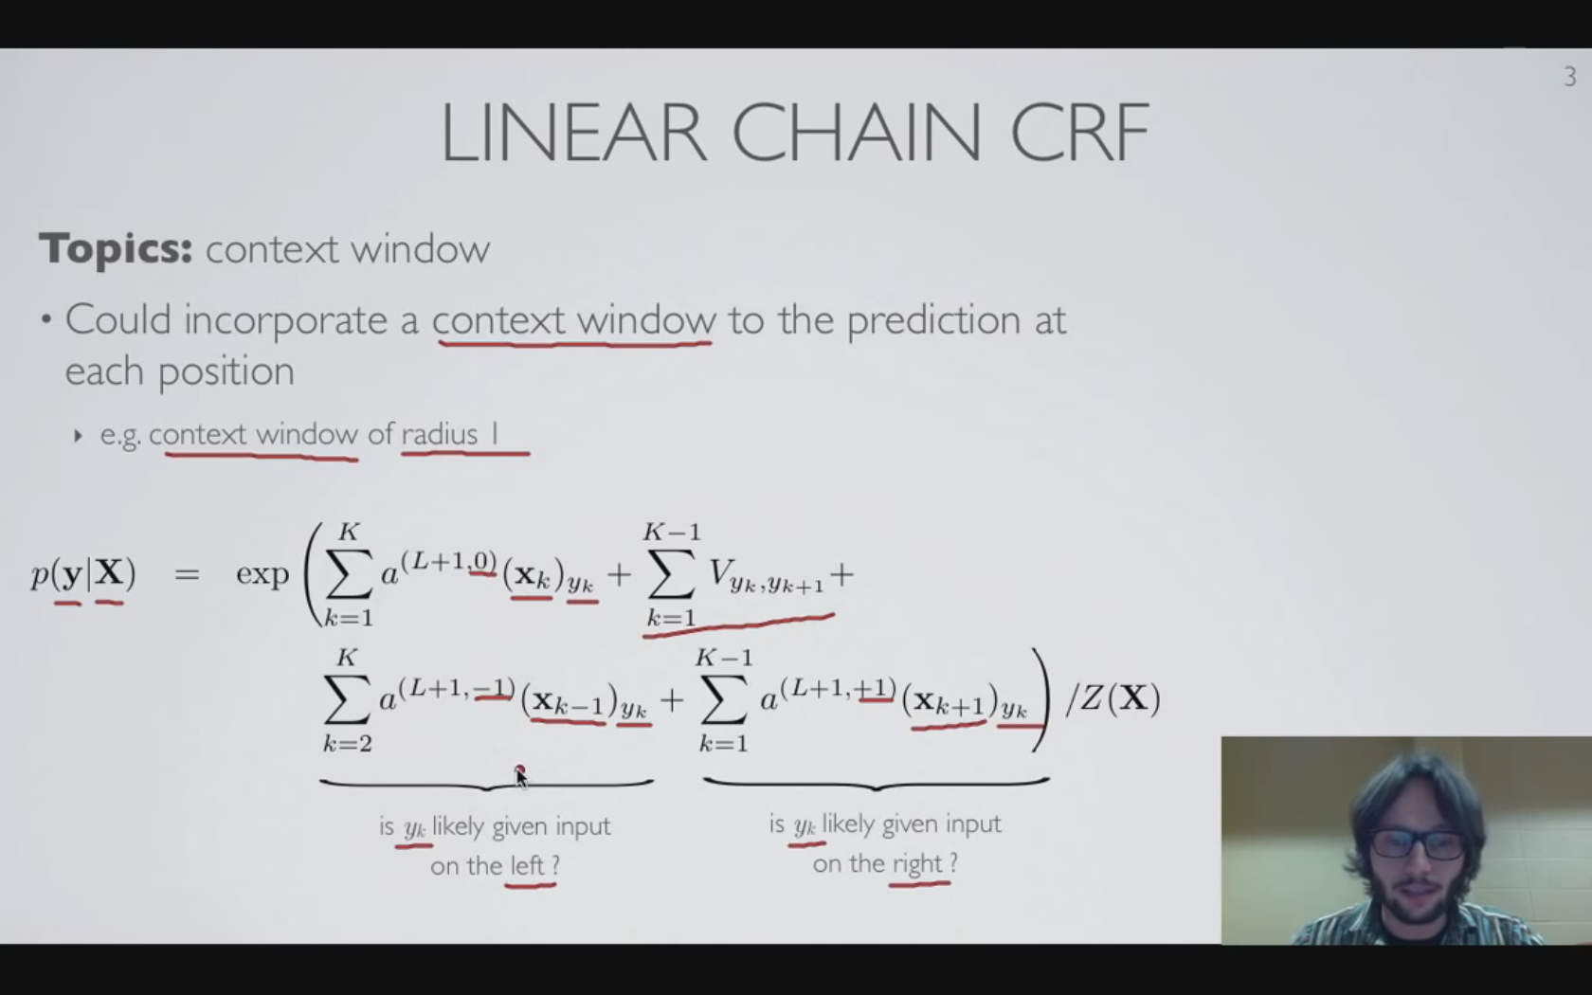
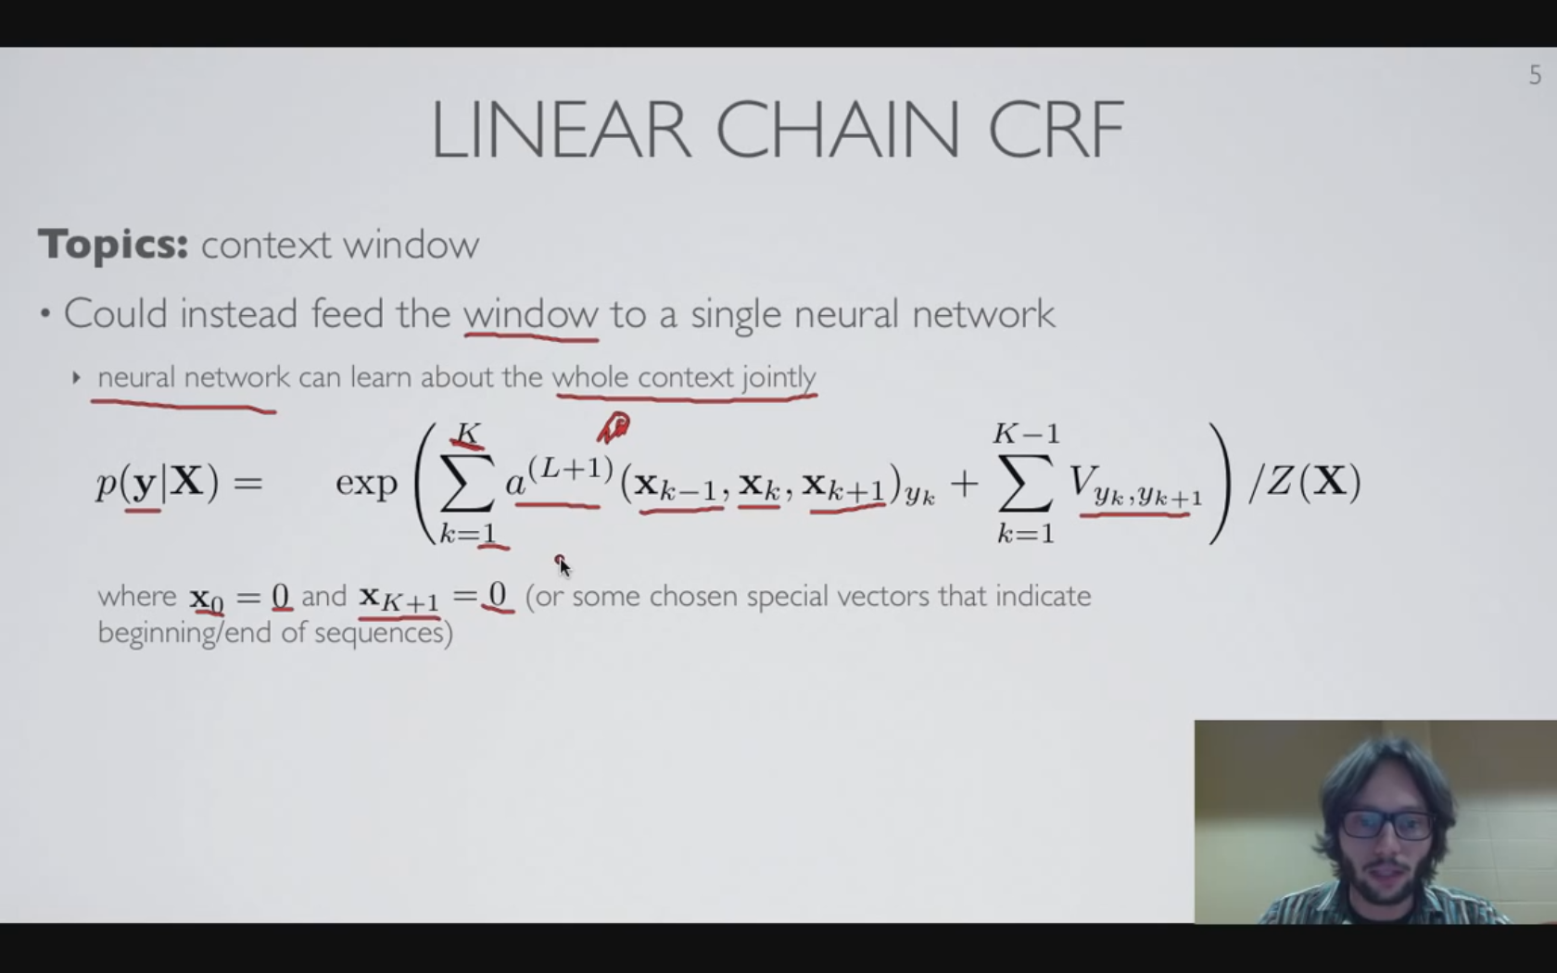
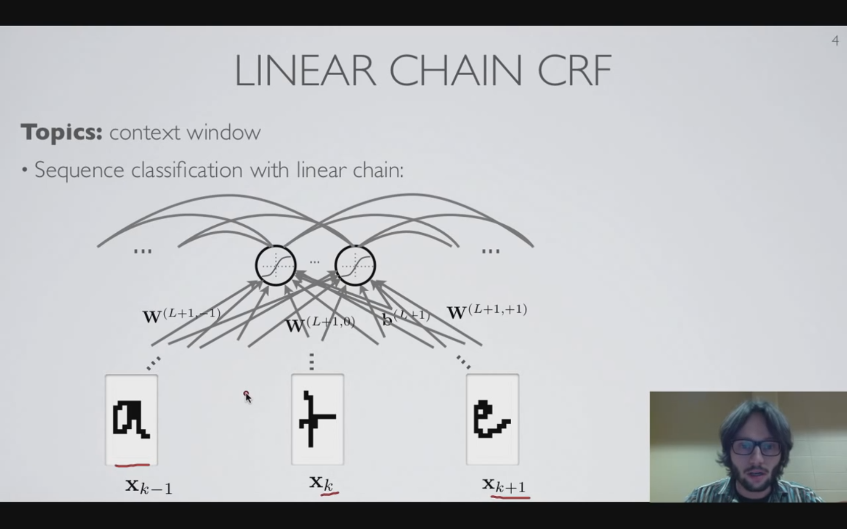
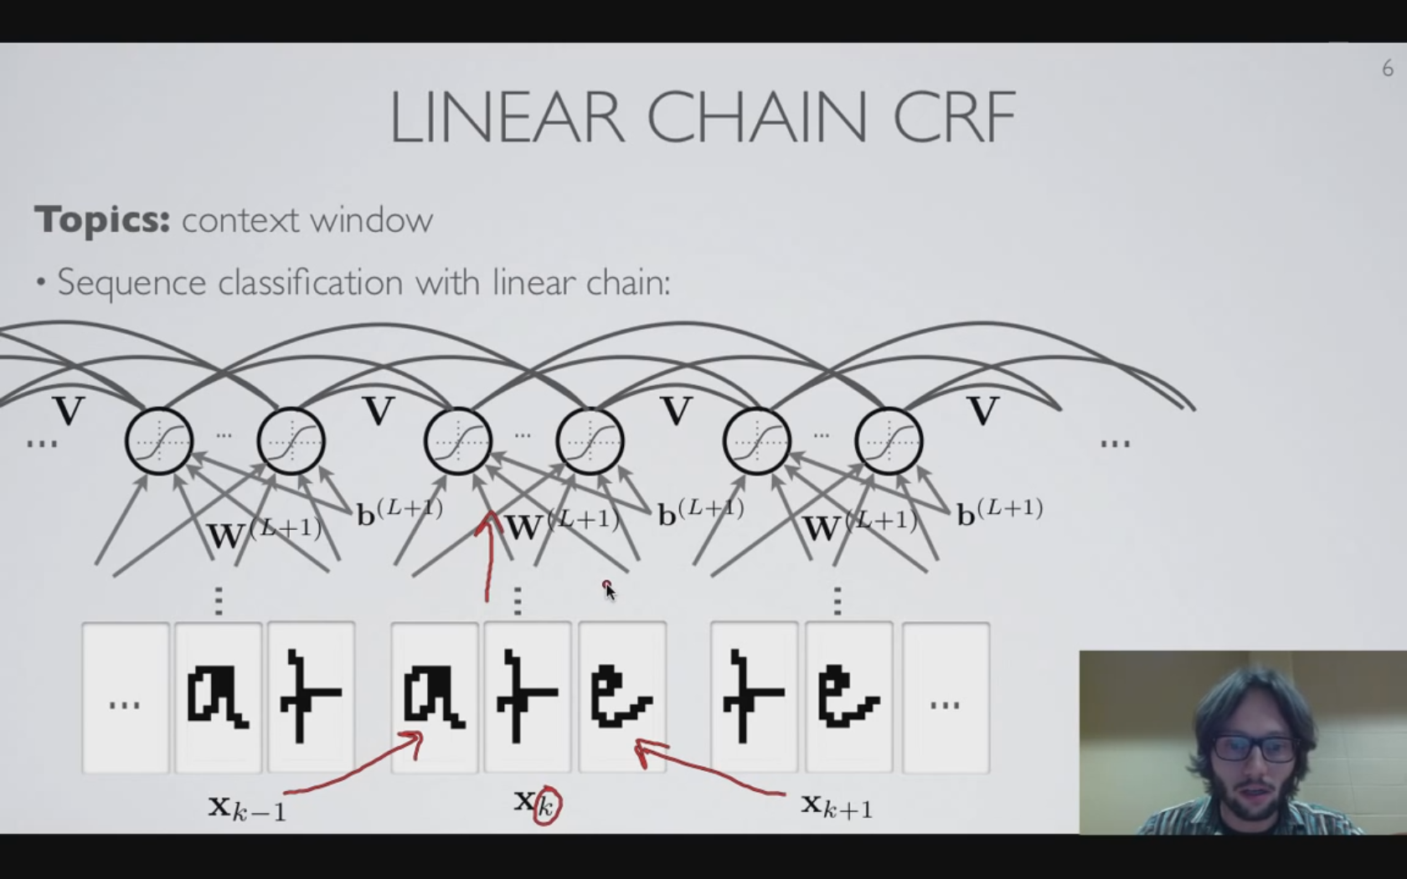
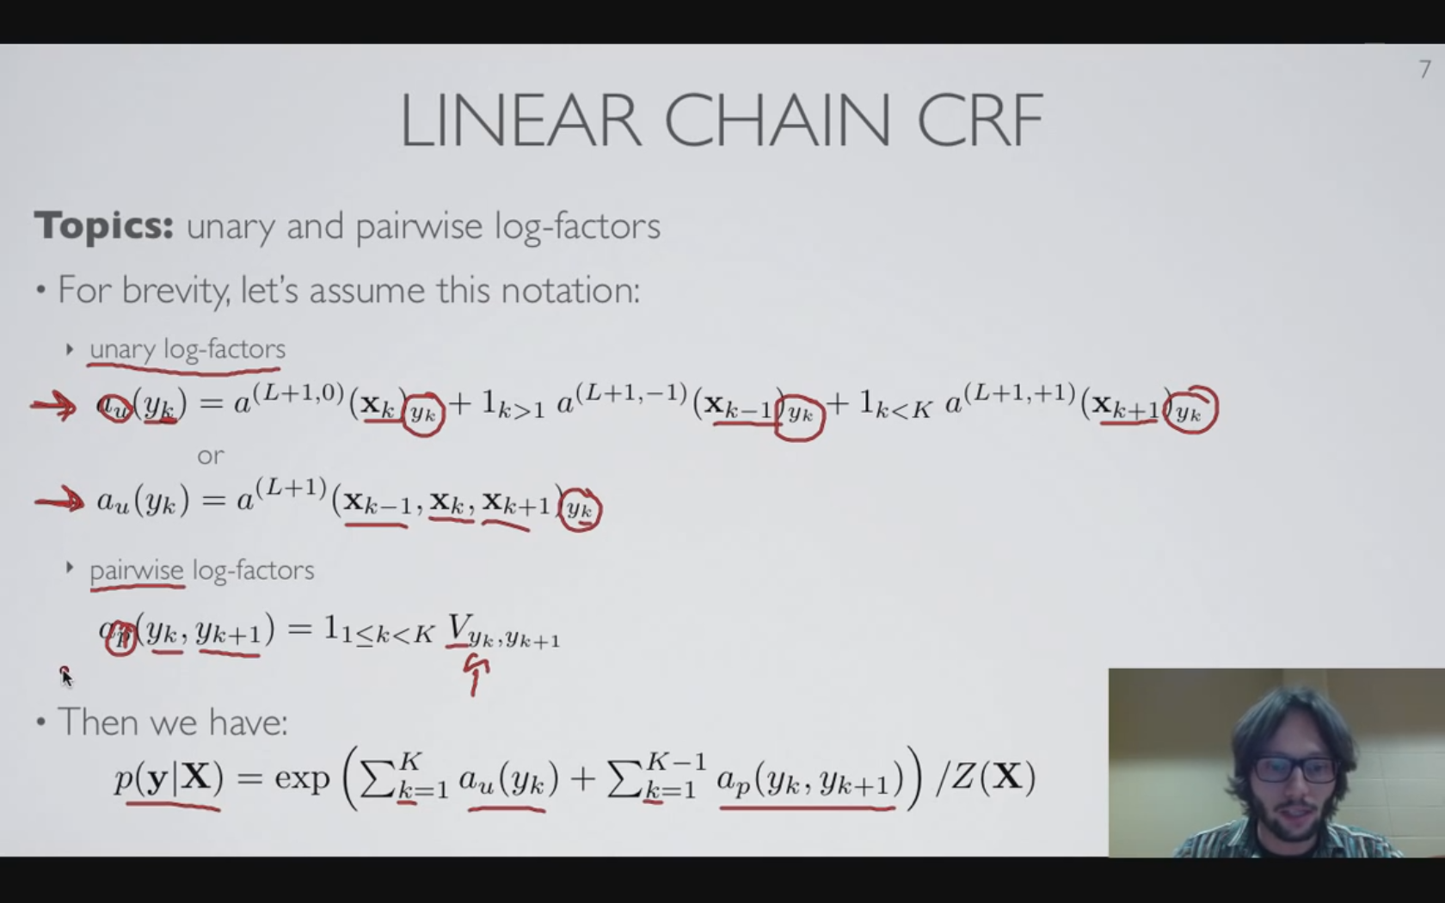
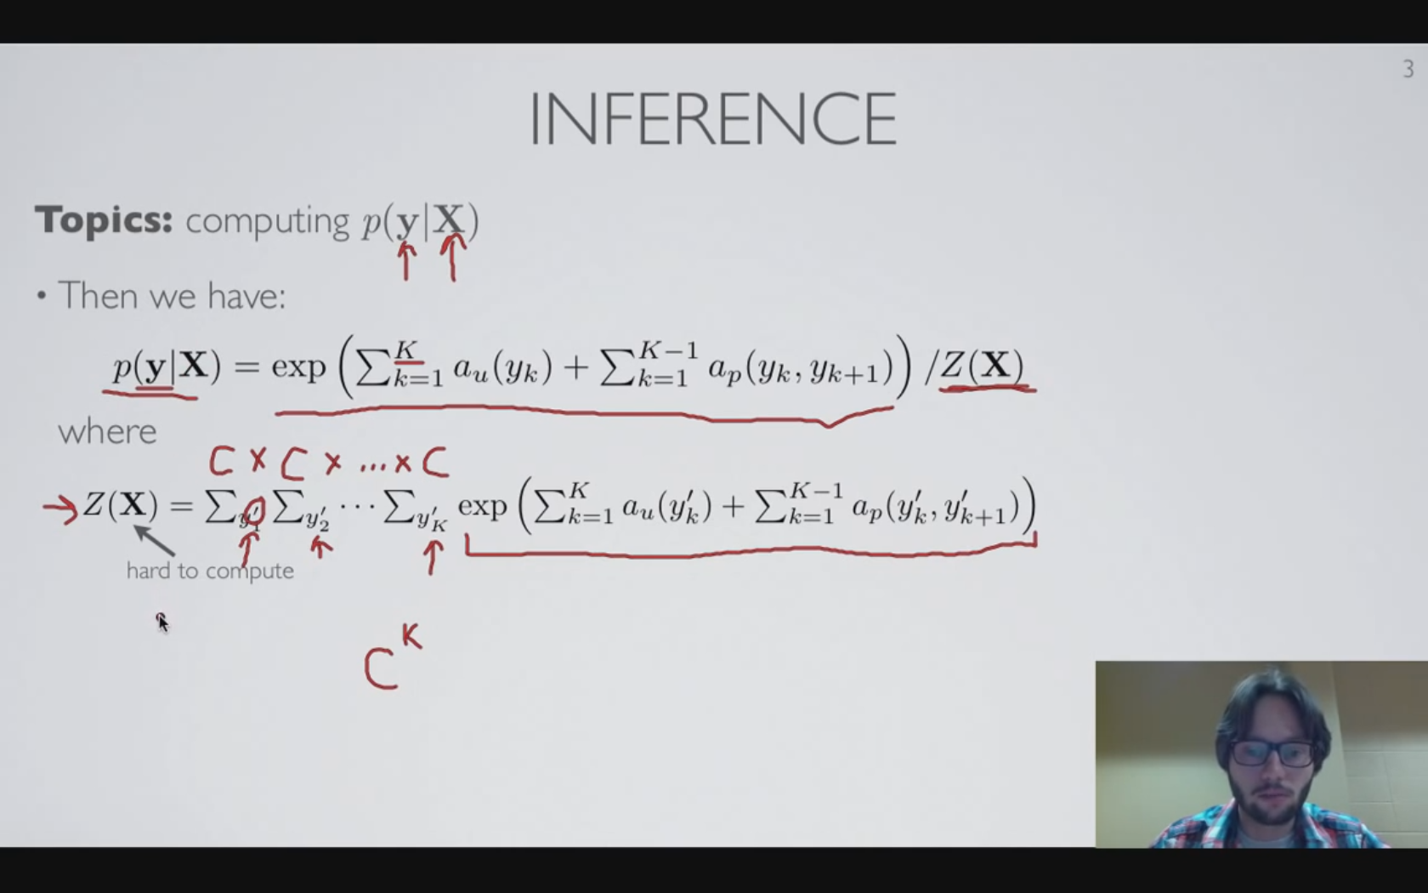
Linear chain CRF -Context Window
Unlike aforementioned high-level only influence, each inputs (lowest level) within a context window can make a direct influence.
Distinctive NN wrt relative position.
Additional regional NN starts from last pre-activation layer of adjacent position (context window)
Single NN covering whole context window with concatenation of adjacent raw inputs.

Slide 5
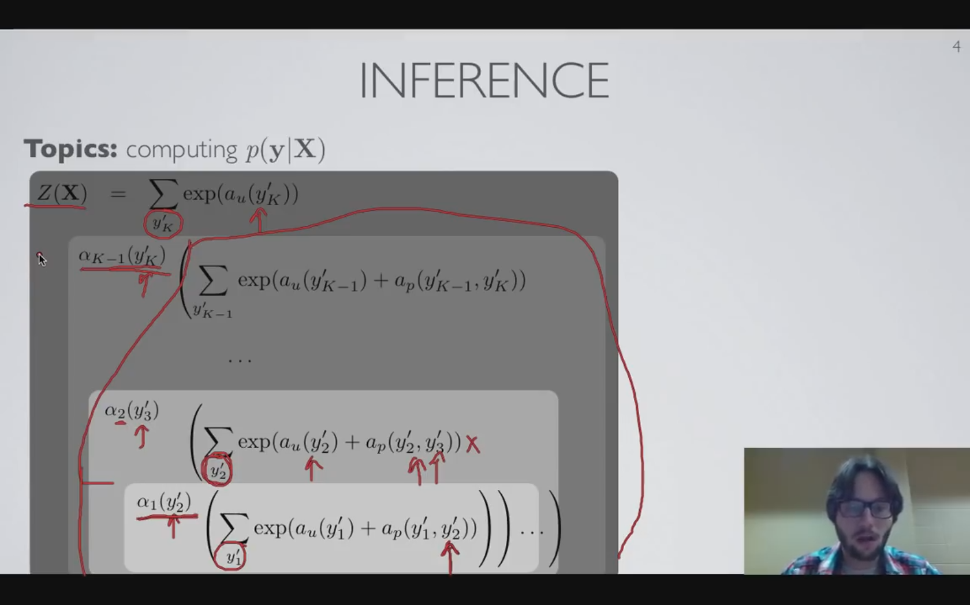
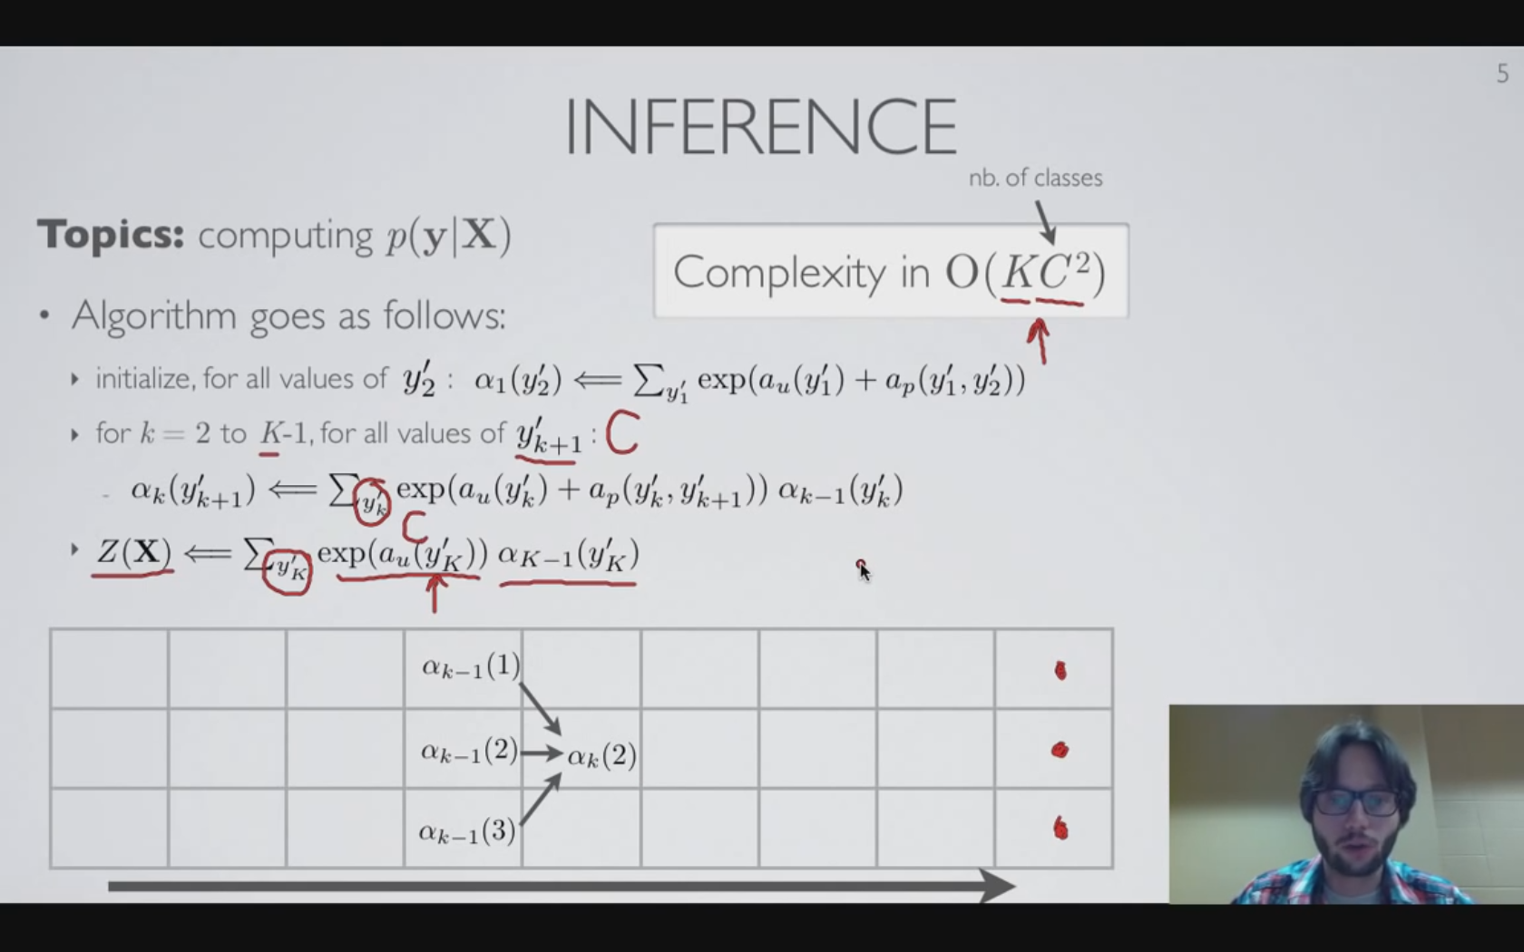
Linear chain CRF -Partition function computation (1)
Naïve approach
Naive computation of the marginal probability W/O dependency consideration
Computational burden: O(C^{K})
Dynamic approach
Nested sum: Care about the limited dependency of CRF
Computational burden: O(KC²)
Utilize α(forward order), or β(backward order) ‘function’ (or a ‘vector’ since C is finite number)
Referred to as the forward/backward algorithm for CRFs
Also called: ‘Belief propagation’, or ‘sum-product’
Marginal probability computation:
Α gives summation from the left whereas β gives summation from the right
Non-linear transformation of same dimension(C)?

Slide 6
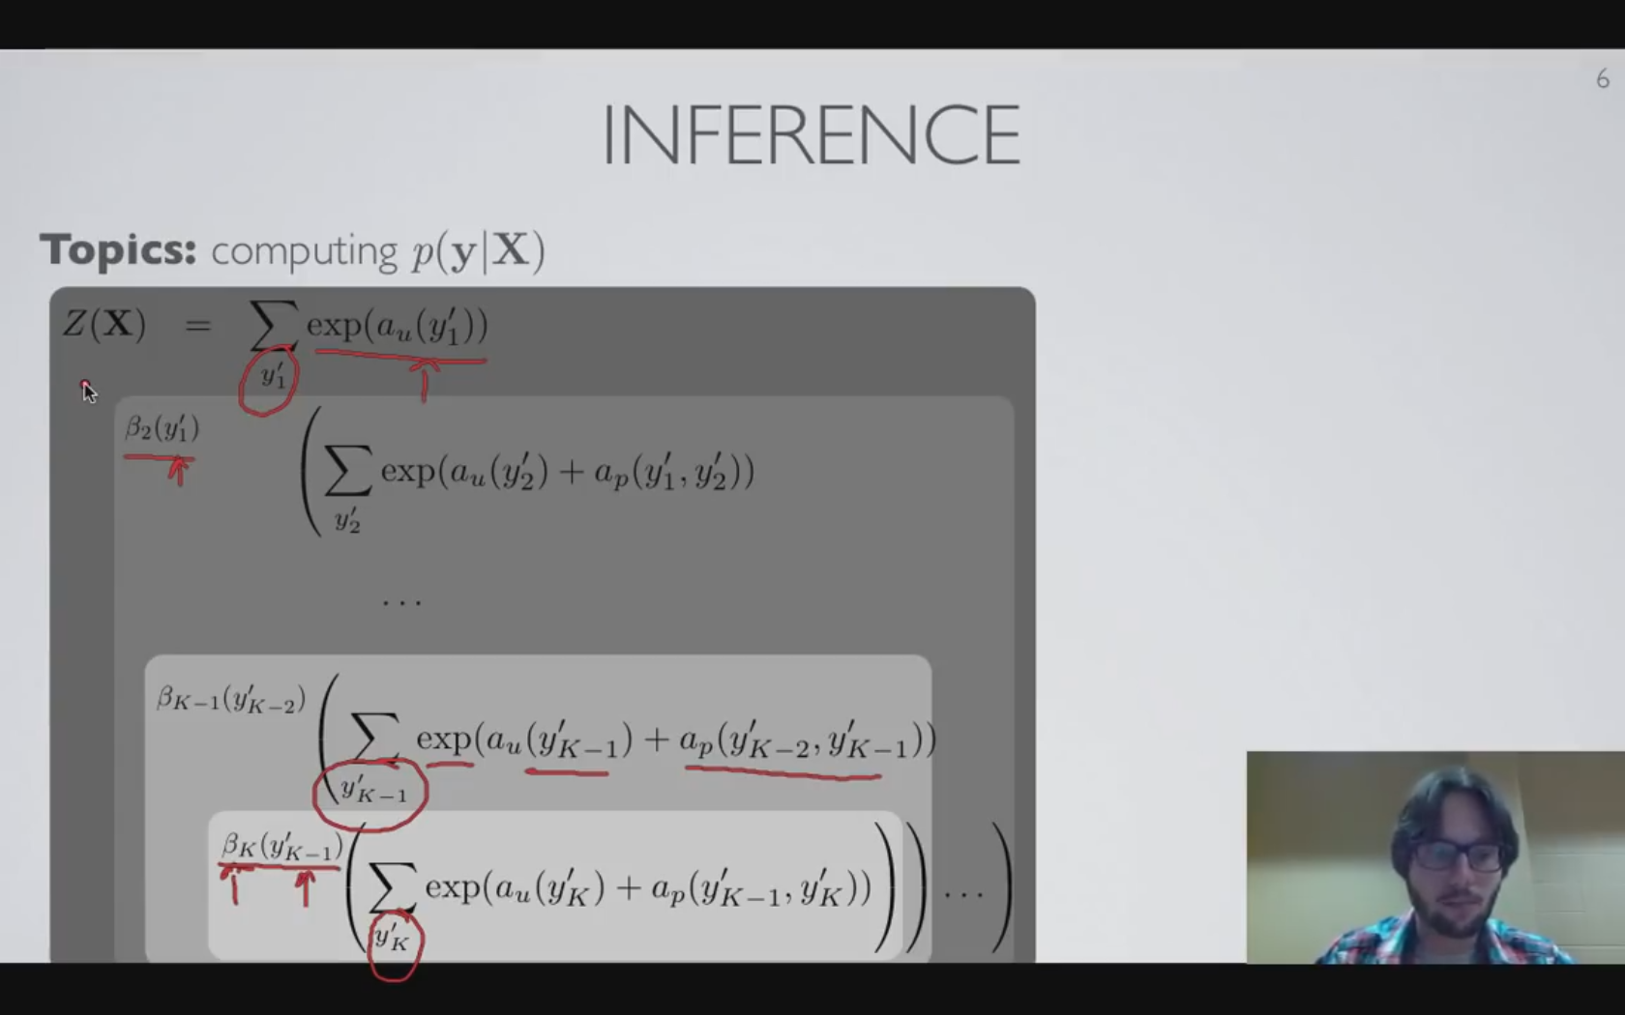
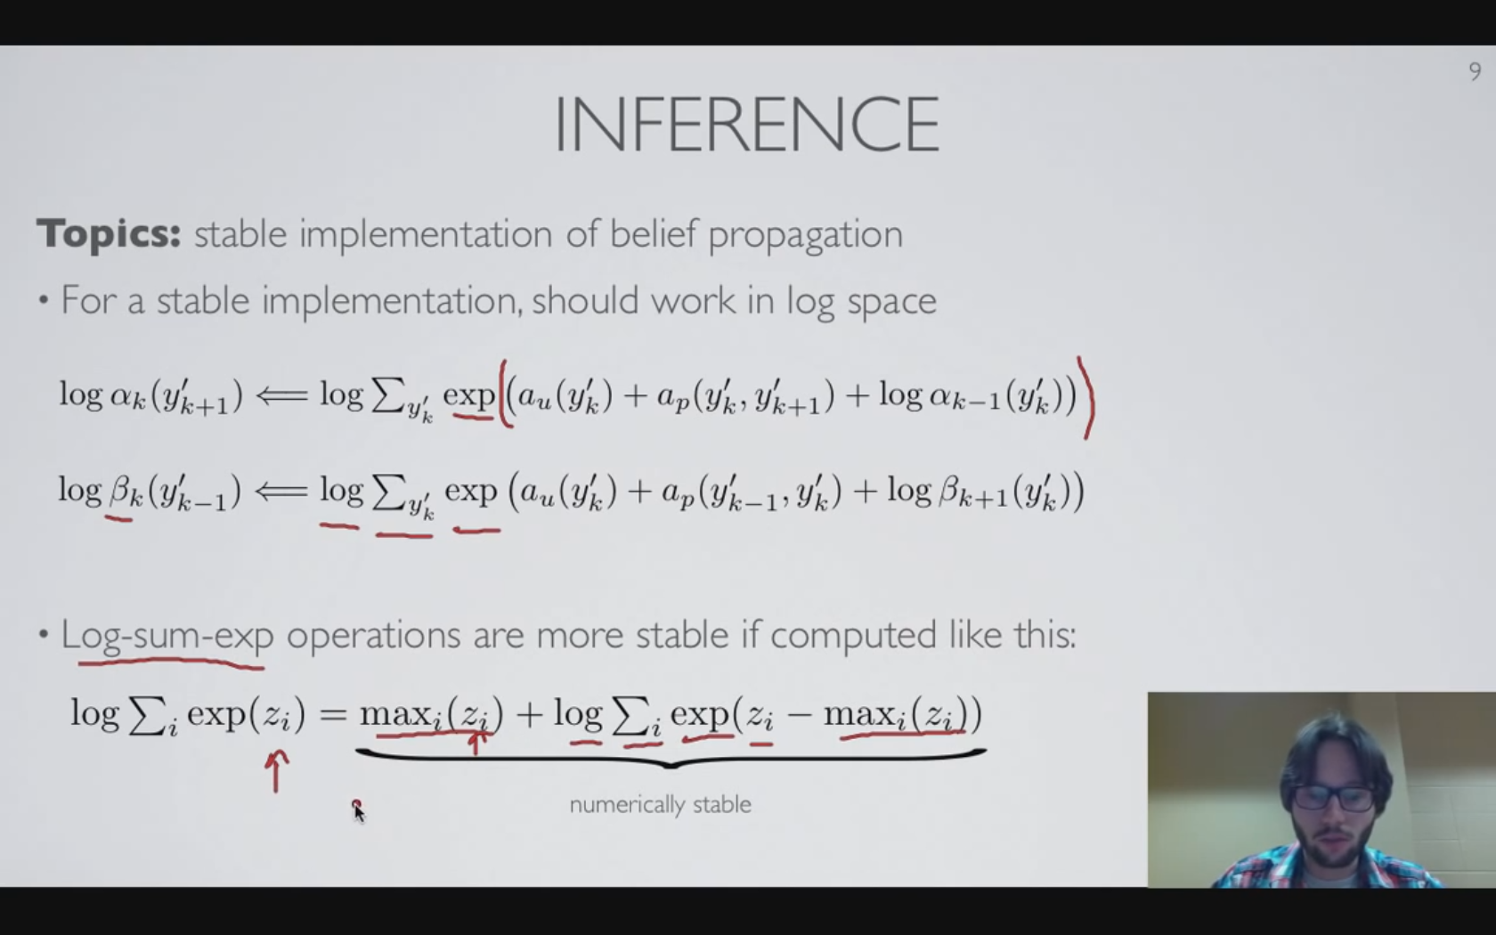
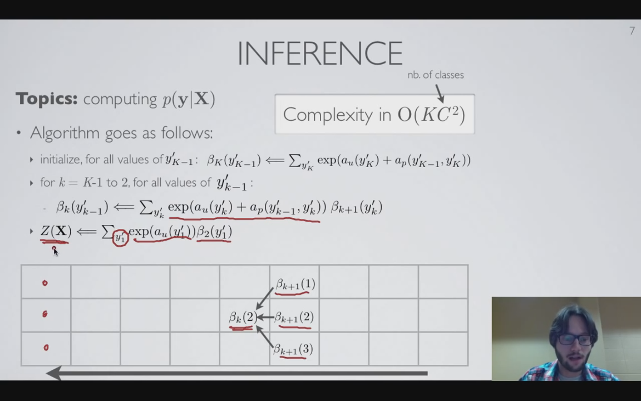
Linear chain CRF -Partition function computation (2)
Numerically stable implementation
Log(α) instead of α, log(β) instead of β
Can be unstable and cause numerical precision problem if one of the exponential power term goes very large

Slide 7
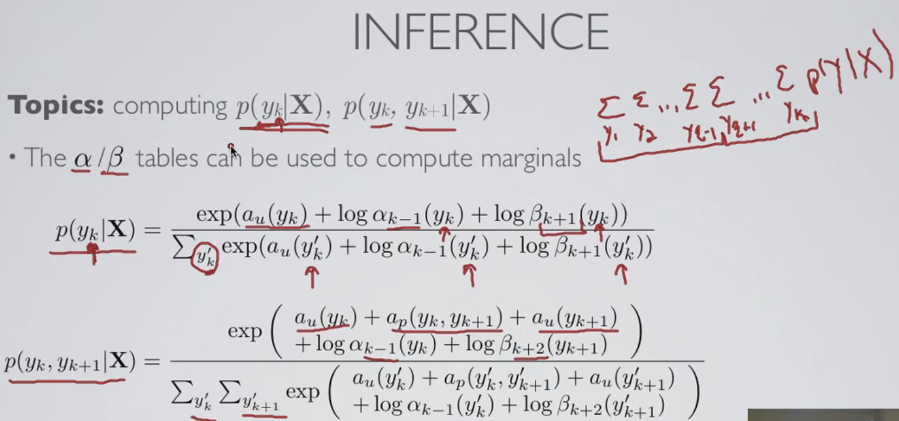
Linear chain CRF -Marginal probability computation
Probability at a single position or of the sequence is needed to train CRF
Everything about how to compute softmax

Slide 8
References
From “Neural Network” by Hugo Larochelle. Lec 3.1~3.5
https://www.youtube.com/user/hugolarochelle

